Slide 1
Input Hardware
Tablet
Tablet a tablet is a digitizer.
- scan over an object and input a set of discrete coordinate positions.
These positions can then be joined with straight line segments to approximate the shape of the original object.
A tablet digitizes an object detecting the position of a movable stylus (a pencil shaped device) or a puck(a mouse like device with cross hairs for sighting positions) held in the user’s hand
Computer Graphics, Nepal College of Information Technology, 2009

Slide 2
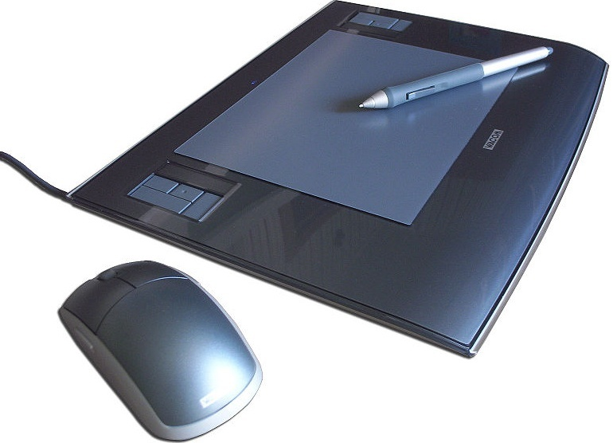
Input Hardware
Computer Graphics, Nepal College of Information Technology, 2009

Slide 3
Input Hardware
i. Electrical Tablet
A grid of wires on ¼ to ½ inch centers is embedded in the tablet surface
Electromagnetic signals generated by electrical pulses applied in sequence to the wires in the grid induce an electrical signal in a wire coil in the stylus or puck
The strength of the signal induced by each pulse is used to determine the position of the stylus.
The signal strength is also used to determine roughly how far the stylus is from the tablet
Computer Graphics, Nepal College of Information Technology, 2009

Slide 4
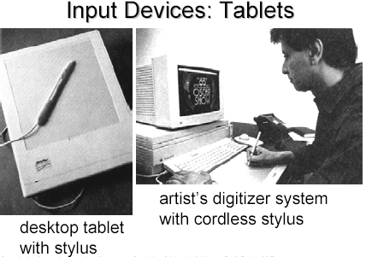
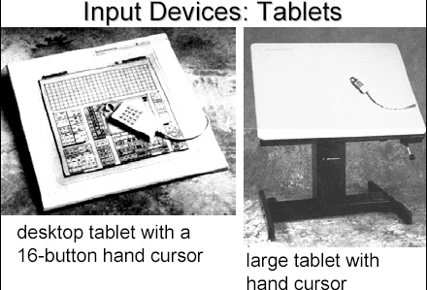
Computer Graphics, Nepal College of Information Technology, 2009

Slide 5
Input Hardware
ii. Sonic Tablet
The sonic tablet uses sound waves to couple the stylus to microphones positioned on the periphery of the digitizing area
An electrical spark at the tip of the stylus creates sound bursts.
The position of the stylus or the coordinate values is calculated using the delay between when the spark occurs and when its sound arrives at each microphone
Computer Graphics, Nepal College of Information Technology, 2009

Slide 6
Input Hardware
The main advantage of sonic tablet is that it doesn’t require a dedicated working area as the microphones can be placed on any surface to form the tablet work area
This facilitates digitizing drawing on thick books because in an electrical tablet this is not convenient for the stylus can not get closer to the tablet surface
Computer Graphics, Nepal College of Information Technology, 2009

Slide 7
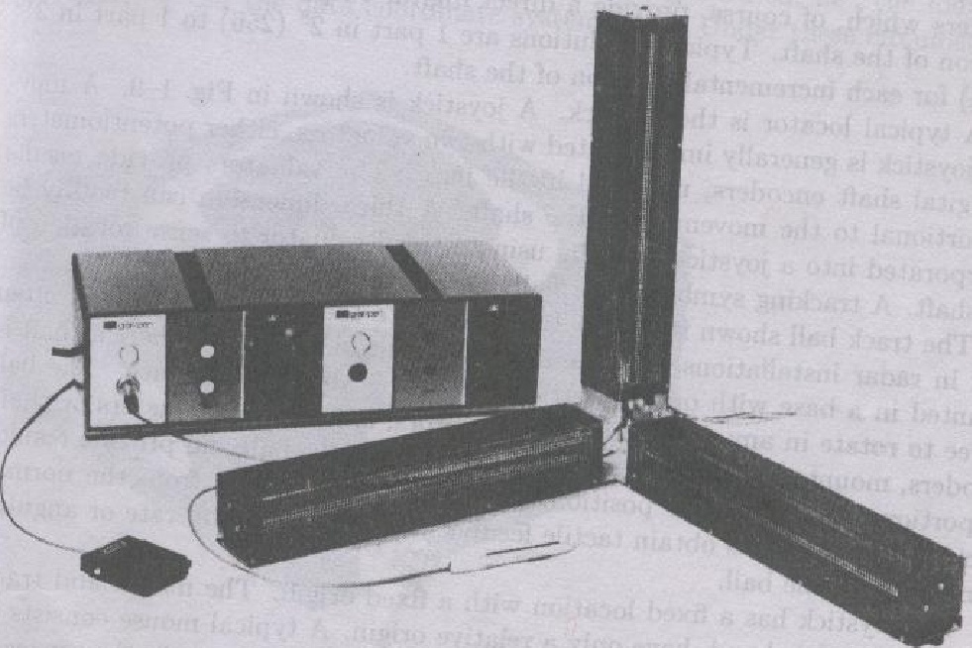
Computer Graphics, Nepal College of Information Technology, 2009

Slide 8
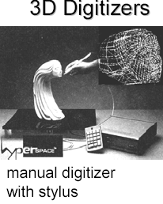
Computer Graphics, Nepal College of Information Technology, 2009

Slide 9
Input Hardware
iii. Resistive Tablet
The tablet is just a piece of glass coated with a thin layer of conducting material
When a battery powered stylus is activated at certain position it emits high frequency radio signals which induces the radio signals on conducting layer.
The strength of the signal received at the edges of the tablet is used to calculate the position of the stylus
Computer Graphics, Nepal College of Information Technology, 2009

Slide 10
Input Hardware
Several types of tablets are transparent, and thus can be backlit for digitizing x-ray films and photographic negatives.
The Resistive tablet can be used to digitize the objects on CRT because it can be curved to the shape of the CRT.
The mechanism used in the electrical or sonic tablets can also be used to digitize the 3D objects
Computer Graphics, Nepal College of Information Technology, 2009

Slide 11
Input Hardware
Touch Panels
The touch panel allows the user to point at the screen directly with a finger to move the cursor around the screen or to select the icons.
i. Optical Touch Panel
It uses a series of infrared light emitting diodes (LED) along one vertical edge and along one horizontal edge of the panel
The opposite vertical and horizontal edges contain photo detectors to form a grid of invisible infrared light beams over the display area.
Computer Graphics, Nepal College of Information Technology, 2009

Slide 12
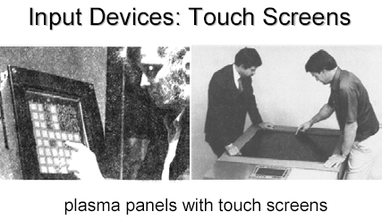
Input Hardware
Touching the screen breaks one or two vertical and horizontal light beams thereby indicating the fingers position
The cursor is then moved to this position or the icon at this position is selected
This is a low resolution panel which offers 10 to 50 positions in each direction
Computer Graphics, Nepal College of Information Technology, 2009

Slide 13
Input Hardware
ii. Sonic Touch Panel
Bursts of high frequency sound waves traveling alternately horizontally and vertically are generated at the edge of the panel .
Touching the screen causes part of each wave to be reflected back to its source
The screen position at the point of contact is then calculated using the time elapsed between when the wave is emitted and when it arrives back at the source
This is a high resolution touch panel having about 500 positions in each direction
Computer Graphics, Nepal College of Information Technology, 2009

Slide 14
Input Hardware
iii. Electrical Touch Panel
It consists of slightly separated two transparent panel one coated with a thin layer of conducting material and the other with resistive material
When the panel is touched with a finger the two plates are forced to touch at the point of contact thereby creating the voltage drop across the resistive plate which is then used to calculate the coordinate of the touched position
The resolution of the touch panel is similar to that of sonic touch panel
Computer Graphics, Nepal College of Information Technology, 2009

Slide 15
Input Hardware
Light pen
It is a pencil shaped device to determine the coordinates of a point on the screen where it is activated such as pressing the button .
In raster display ‘y’ is set at y_{max} and ‘x’ changes from 0 to x_{max} the first scan line .
For the second line ‘y’ decreases by one and ‘x’ again changes from 0 to x_{max} and so on
When activated light pen sees a burst of light at certain position as the electron beam hits the phosphor coating at that position it generates an electric pulse
Computer Graphics, Nepal College of Information Technology, 2009

Slide 16
Input Hardware
This is used to save the video controller’s ‘x’ and ‘y’ registers and interrupt the computer
By reading the saved valued the graphics package can determine the coordinates of the position seen by the light pen
Drawbacks
i. Light pen obscures screen images as it is pointed to required spot
ii. Prolong use of it can cause arm fatigue
iii. It cannot report the coordinates of a point that is completely black as a remedy one can display a dark blue field in place of the regular image for a single frame time
iv. It gives sometimes false reading due to back ground lighting in a room
Computer Graphics, Nepal College of Information Technology, 2009

Slide 17
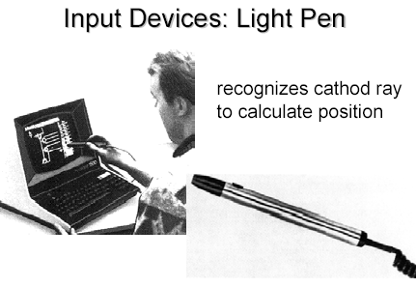
Computer Graphics, Nepal College of Information Technology, 2009

Slide 18
Display Devices
Fluorescence / Phosphorescence
A phosphors fluorescence is the light emitted as the very unstable electrons lose their excess energy whole the phosphor is being struck by electrons
Phosphorescence is the light given off by the return of the relatively more stable excited electrons to their unexcited state once the electron beam excitation is removed
Computer Graphics, Nepal College of Information Technology, 2009

Slide 19
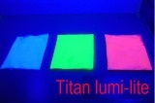
Display Devices
Persistence
A phosphor’s persistence is defined as the time from the removal of excitation to the moment when phosphorescence has decay to 10 percent of the initial light output
The range of persistence of different phosphors can reach many seconds
The phosphors used for graphics display devices usually have persistence of 10 to 60 micro seconds
A phosphor with low persistence is useful for animation and a high persistence phosphor is useful to highly complex static pictures
Computer Graphics, Nepal College of Information Technology, 2009

Slide 20
Display Devices
The factors affecting the CFF are:
i. Persistence: longer the persistence the lower the CFF But the relation between the CFF and persistence is non linear
ii. Image intensity: Increasing the image intensity increases the CFF with non linear relationship
iii. Ambient room light Decreasing the ambient room light increases the CFF with nonlinear relationship
iv. Wave lengths of emitted light
v. Observer
Computer Graphics, Nepal College of Information Technology, 2009

Slide 21
Display Devices
Refresh rate
The refresh rate is the number of times per second the image is redrawn to give a feeling of un-flickering pictures and it is usually 50 per second
As the refresh rate decreases flicker develops because the eye can no longer integrate the individual light impulses coming from a pixel
The refresh rate above which a picture stops flickering and fuses into a steady image is called the critical fusion frequency (CFF)
Computer Graphics, Nepal College of Information Technology, 2009

Slide 22

Display Devices
Resolution
Resolution is defined as the maximum number of points that can be displayed horizontally and vertically with out overlap on a display device
Factors affecting the resolution are as follows
i. Spot profile:
The spot intensity has a Gaussian distribution. So two adjacent spots on the display device appear distinct as long as their separation D₂ is greater than the diameter of the spot D₁ at which each spot has an intensity of about 60 percent of that at the center of the spot
Intensity 60%
D₁
D₂
Computer Graphics, Nepal College of Information Technology, 2009

Slide 23
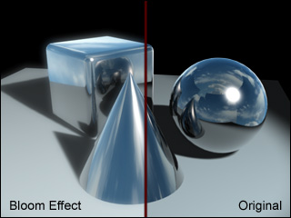
Display Devices
Intensity:
As the intensity of the electron beam increases the spot size on the display tends to increase because of spreading of energy beyond the point of bombardment
This phenomenon is called blooming Consequently , the resolution decreases.
Thus it is noted that resolution is no necessarily a constant and it is not necessarily equal to the resolution of a pix-map, which is allocated in a buffer memory
Computer Graphics, Nepal College of Information Technology, 2009

Slide 24
Display Devices
Color CRTs
Color depends on the light emitted by phosphor.
Two type:
Beam Penetration Method
Shadow Mask Method
Computer Graphics, Nepal College of Information Technology, 2009

Slide 25
Display Devices
i. Beam Penetration Method:
Two different layers of phosphor coating used Red (outer) and Green
(inner)
Display of color depends on the depth of penetration of the electron beam
into the phosphor layers
A beam of slow electrons excites only the outer red layer
A beam of very fast electrons penetrates thru the red phosphor and excites
the inner green layer
When quantity of red is more than green then color appears as orange
When quantity of green is more than red then color appears as yellow
Screen color is controlled by the beam acceleration voltage.
Only four colors possible, poor picture quality
Computer Graphics, Nepal College of Information Technology, 2009

Slide 26
Display Devices
ii. Shadow Mask Method
The inner side of the viewing surface of a color CRT consists of closely spaced groups of red, green and blue phosphor dots.
Each group is called a triad
A thin metal plate perforated with many small holes is mounted close to the inner side of the viewing surface. This plate is called shadow mask
The shadow mask is mounted in such a way that each hole is correctly aligned with a triad in color CRT
Computer Graphics, Nepal College of Information Technology, 2009

Slide 27
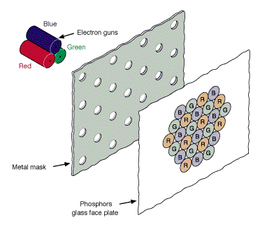
Display Devices
There are three electron guns one for each dot in a triad
The electron beam form each gun therefore hits only the corresponding dot of a triad as the three electron beams deflect
A triad is so small that light emanating from the individual dots is perceived by the viewer as a mixture of the three colors
Thus, a wide range of colors can be produced by each triad depending on how strongly each individual phosphor dot in a triad is excited.
Computer Graphics, Nepal College of Information Technology, 2009

Slide 28
Display Devices
a. A Delta –Delta CRT
A triad has a triangular (delta) pattern as are the three electron guns
Main drawback of this type of CRT is that a high precision display is very difficult to achieve because of technical difficulties involved in the alignment of shadow mask holes and the triad on one to one basis
b. Precision Inline CRT
A triad has an in-line pattern as are the three electron guns
The introduction of this type of CRT has eliminated the main drawback of a Delta-Delta CRT
But a slight reduction of image sharpness at the edges of the tube has been noticed
Normally 1000 scan lines can be achieved
Computer Graphics, Nepal College of Information Technology, 2009

Slide 29
i. Vector Display Technology
CPU
Peripheral Devices
System Bus
System Memory
Display Processor
Monitor
.
.
MoveTo(10,10)
LineTo(639,479)
.
.
.
Display List ->
Computer Graphics, Nepal College of Information Technology, 2009

Slide 30
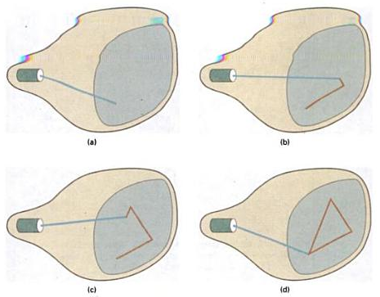
i. Vector Display Technology
Computer Graphics, Nepal College of Information Technology, 2009

Slide 31
i. Vector Display Technology
It is also called random scan, a stroke, a line drawing or calligraphic display
Advantages:
i. It can produce a smooth output primitives with higher resolution unlike the raster display technology
ii. It is better than raster display for real time dynamics such as animation
iii. For transformation, only the end points has to be moved to the new position in vector display but in raster display it is necessary to move those end points and at the same time all the pixels between the end points must be scan converted using appropriate algorithm
No prior information on pixels can be reused
Computer Graphics, Nepal College of Information Technology, 2009

Slide 32
i. Vector Display Technology
Disadvantages:
i. A vector display can not fill areas with patterns and manipulate bits
ii. Time required for refreshing an image depends upon its complexity (more the lines, longer the time) the flicker may therefore appear as the complexity of the image increases. The fastest vector display can draw about 100000 short vectors in a refresh cycle without flickering
Computer Graphics, Nepal College of Information Technology, 2009

Slide 33
ii. Raster Display Technology
CPU
Peripheral Devices
System Bus
System Memory
Video Controller
Monitor
0 0 0 0 0 0 0 0 0 0 0 1 0 0 0 0 0 0 0 0
0 0 1 0 0 0 0 0 0 0
0 0 0 1 0 0 0 0 0 0
0 0 0 0 1 0 0 0 0 0
Frame Buffer ->
Computer Graphics, Nepal College of Information Technology, 2009

Slide 34
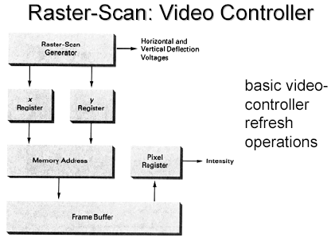
ii. Raster Display Technology
Computer Graphics, Nepal College of Information Technology, 2009

Slide 35
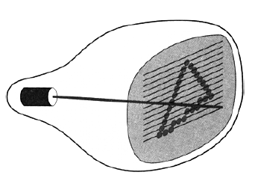
ii. Raster Display Technology
Computer Graphics, Nepal College of Information Technology, 2009

Slide 36
ii. Raster Display Technology
Advantages
i. It has an ability to fill the areas with solid colors or patterns
ii. The time required for refreshing is independent of the complexity of the image
iii. Low cost
Computer Graphics, Nepal College of Information Technology, 2009

Slide 37
ii. Raster Display Technology
Disadvantages
i. For Real-Time dynamics not only the end points are required to move but all the pixels in between the moved end points have to be scan converted with appropriate algorithms which might slow down the dynamic process
ii. Due to scan conversion “jaggies” or “stair-casing” are unavoidable
Computer Graphics, Nepal College of Information Technology, 2009

Slide 38
RDT/VDT
Computer Graphics, Nepal College of Information Technology, 2009

Slide 39
Frame Buffer
0 0 0 0 0 0 0 0 0 0 0 1 0 0 0 0 0 0 0 0
0 0 1 0 0 0 0 0 0 0
0 0 0 1 0 0 0 0 0 0
0 0 0 0 1 0 0 0 0 0
DAC
Screen
1
Electron
Gun
Register
Frame Buffer
Computer Graphics, Nepal College of Information Technology, 2009

Slide 40
Frame Buffer
0 0 0 0 0 0 0 0 0 1 0 1 0 0 0 0 0 0 0 0
0 0 1 0 0 0 0 0 0 0
0 0 0 1 0 0 0 0 0 0
0 0 0 0 1 0 0 0 0 0
DAC
Screen
1
Electron
Gun
Register
Frame Buffer
Computer Graphics, Nepal College of Information Technology, 2009

Slide 41
Frame Buffer
0 0 0 0 0 0 0 0 0 1 0 1 0 0 0 0 0 0 0 0
0 0 1 0 0 0 0 0 0 0
0 0 0 1 0 0 0 0 0 0
0 0 0 0 1 0 0 0 0 0
1
DAC
r
Screen
0 0 0 0 0 0 0 0 0 1 0 1 0 0 0 0 0 0 0 0
0 0 1 0 0 0 0 0 0 0
0 0 0 1 0 0 0 0 0 0
0 0 0 0 1 0 0 0 0 0
1
DAC
0 0 0 0 0 0 0 0 0 0 0 1 0 0 0 0 0 0 0 0
0 0 1 0 0 0 0 0 0 0
0 0 0 1 0 0 0 0 0 0
0 0 0 0 1 0 0 0 0 0
0
DAC
Electron
Guns
Registers
Frame Buffer
Computer Graphics, Nepal College of Information Technology, 2009

Slide 42
Frame Buffer
0 0 0 0 0 0 0 0 0 1 0 1 0 0 0 0 0 0 0 0
0 0 1 0 0 0 0 0 0 0
0 0 0 1 0 0 0 0 0 0
0 0 0 0 1 0 0 0 0 0
1
DAC
r
Screen
0 0 0 0 0 0 0 0 0 1 0 1 0 0 0 0 0 0 0 0
0 0 1 0 0 0 0 0 0 0
0 0 0 1 0 0 0 0 0 0
0 0 0 0 1 0 0 0 0 0
1
DAC
0 0 0 0 0 0 0 0 0 1 0 1 0 0 0 0 0 0 0 0
0 0 1 0 0 0 0 0 0 0
0 0 0 1 0 0 0 0 0 0
0 0 0 0 1 0 0 0 0 0
1
DAC
Electron
Guns
Registers
Frame Buffer
Computer Graphics, Nepal College of Information Technology, 2009

Slide 43
Frame Buffer
0 0 0 0 0 0 0 0 0 1 0 1 0 0 0 0 0 0 0 0
0 0 1 0 0 0 0 0 0 0
0 0 0 1 0 0 0 0 0 0
0 0 0 0 1 0 0 0 0 0
8 Bit Planes
0 0 0 0 0 0 0 0 0 1 0 1 0 0 0 0 0 0 0 0
0 0 1 0 0 0 0 0 0 0
0 0 0 1 0 0 0 0 0 0
0 0 0 0 1 0 0 0 0 0
0 0 0 0 0 0 0 0 0 1 0 1 0 0 0 0 0 0 0 0
0 0 1 0 0 0 0 0 0 0
0 0 0 1 0 0 0 0 0 0
0 0 0 0 1 0 0 0 0 0
0 0 0 0 0 0 0 0 0 1 0 1 0 0 0 0 0 0 0 0
0 0 1 0 0 0 0 0 0 0
0 0 0 1 0 0 0 0 0 0
0 0 0 0 1 0 0 0 0 0
0 0 0 0 0 0 0 0 0 1 0 1 0 0 0 0 0 0 0 0
0 0 1 0 0 0 0 0 0 0
0 0 0 1 0 0 0 0 0 0
0 0 0 0 1 0 0 0 0 0
0 0 0 0 0 0 0 0 0 1 0 1 0 0 0 0 0 0 0 0
0 0 1 0 0 0 0 0 0 0
0 0 0 1 0 0 0 0 0 0
0 0 0 0 1 0 0 0 0 0
0 0 0 0 0 0 0 0 0 1 0 1 0 0 0 0 0 0 0 0
0 0 1 0 0 0 0 0 0 0
0 0 0 1 0 0 0 0 0 0
0 0 0 0 1 0 0 0 0 0
1 1 1 1 1 1 1 1
1
1
1
1
1
1
1
1
8 Bit DAC
Screen
0 0 0 0 0 0 0 0 0 1 0 1 0 0 0 0 0 0 0 0
0 0 1 0 0 0 0 0 0 0
0 0 0 1 0 0 0 0 0 0
0 0 0 0 1 0 0 0 0 0
0 0 0 0 0 0 0 0 0 1 0 1 0 0 0 0 0 0 0 0
0 0 1 0 0 0 0 0 0 0
0 0 0 1 0 0 0 0 0 0
0 0 0 0 1 0 0 0 0 0
0 0 0 0 0 0 0 0 0 1 0 1 0 0 0 0 0 0 0 0
0 0 1 0 0 0 0 0 0 0
0 0 0 1 0 0 0 0 0 0
0 0 0 0 1 0 0 0 0 0
0 0 0 0 0 0 0 0 0 1 0 1 0 0 0 0 0 0 0 0
0 0 1 0 0 0 0 0 0 0
0 0 0 1 0 0 0 0 0 0
0 0 0 0 1 0 0 0 0 0
0 0 0 0 0 0 0 0 0 1 0 1 0 0 0 0 0 0 0 0
0 0 1 0 0 0 0 0 0 0
0 0 0 1 0 0 0 0 0 0
0 0 0 0 1 0 0 0 0 0
0 0 0 0 0 0 0 0 0 1 0 1 0 0 0 0 0 0 0 0
0 0 1 0 0 0 0 0 0 0
0 0 0 1 0 0 0 0 0 0
0 0 0 0 1 0 0 0 0 0
1
1
1
1
1
1
1
1
8 Bit DAC
1 1 1 1 1 1 1 1
Electron
Guns
Registers
Frame Buffer
0 0 0 0 0 0 0 0 0 0 0 1 0 0 0 0 0 0 0 0
0 0 1 0 0 0 0 0 0 0
0 0 0 1 0 0 0 0 0 0
0 0 0 0 1 0 0 0 0 0
0 0 0 0 0 0 0 0 0 1 0 1 0 0 0 0 0 0 0 0
0 0 1 0 0 0 0 0 0 0
0 0 0 1 0 0 0 0 0 0
0 0 0 0 1 0 0 0 0 0
0 0 0 0 0 0 0 0 0 1 0 1 0 0 0 0 0 0 0 0
0 0 1 0 0 0 0 0 0 0
0 0 0 1 0 0 0 0 0 0
0 0 0 0 1 0 0 0 0 0
0 0 0 0 0 0 0 0 0 1 0 1 0 0 0 0 0 0 0 0
0 0 1 0 0 0 0 0 0 0
0 0 0 1 0 0 0 0 0 0
0 0 0 0 1 0 0 0 0 0
0 0 0 0 0 0 0 0 0 1 0 1 0 0 0 0 0 0 0 0
0 0 1 0 0 0 0 0 0 0
0 0 0 1 0 0 0 0 0 0
0 0 0 0 1 0 0 0 0 0
0 0 0 0 0 0 0 0 0 1 0 1 0 0 0 0 0 0 0 0
0 0 1 0 0 0 0 0 0 0
0 0 0 1 0 0 0 0 0 0
0 0 0 0 1 0 0 0 0 0
1
1
1
1
1
1
1
1
8 Bit DAC
1 1 1 1 1 1 1 1
Computer Graphics, Nepal College of Information Technology, 2009

Slide 44
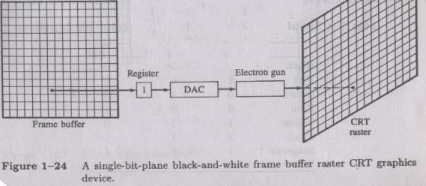
Computer Graphics, Nepal College of Information Technology, 2009

Slide 45
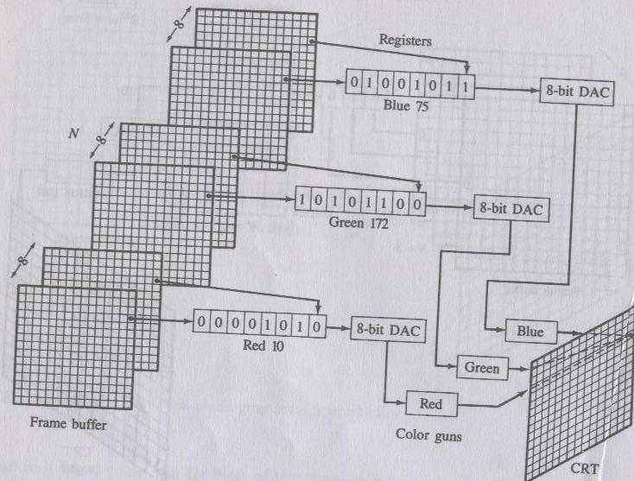
Computer Graphics, Nepal College of Information Technology, 2009

Slide 46
0 0 0 0 0 0 0 0 0 1 0 1 0 0 0 0 0 0 0 0
0 0 1 0 0 0 0 0 0 0
0 0 0 1 0 0 0 0 0 0
0 0 0 0 1 0 0 0 0 0
2^{n}
0 0 0 0 0 0 0 0 0 1 0 1 0 0 0 0 0 0 0 0
0 0 1 0 0 0 0 0 0 0
0 0 0 1 0 0 0 0 0 0
0 0 0 0 1 0 0 0 0 0
Intensity
Levels
2^{n} bit DAC
0 0 0 0 0 0 0 0 0 1 0 1 0 0 0 0 0 0 0 0
0 0 1 0 0 0 0 0 0 0
0 0 0 1 0 0 0 0 0 0
0 0 0 0 1 0 0 0 0 0
1
1
1
n
Registers
Electron
Gun
Screen
n
Frame Buffer
The maximum number of intensity
levels achievable from a single pixel
on the screen
2^{n} where n is the number of
bits used to represent that
single pixel
Computer Graphics, Nepal College of Information Technology, 2009

Slide 47
Refresh rate
  When electron beam strikes a dot in CRT, the surface of the CRT only glows for a fraction of a second and then fades.
  Monitor must redraw the picture many times per second to avoid having the screen flicker
Computer Graphics, Nepal College of Information Technology, 2009

Slide 48
Refresh rate
  The refresh rate is the number of times per second that monitor redraws the images on the screen.
  Very few people notice flicker at refresh rates above 72 Hz.
  Higher refresh rates are preferred for better comfort in viewing the monitor
Computer Graphics, Nepal College of Information Technology, 2009

Slide 49
Quality of a CRT Monitor
Depends largely on its resolution, dot pitch, and refresh rate
Resolution describes the sharpness and clearness of an image
Manufacturers state the resolution of a monitor in pixel
  Example: 800 X 600
A pixel (picture element) is a single point in an electronic image
  A pixel is the smallest element in an electronic image
Computer Graphics, Nepal College of Information Technology, 2009

Slide 50
Video Cards and CRT Monitors
Many CRT monitors use an analog signal to produce an image
Video card converts digital output from the computer into an analog video signal and sends the signal through a cable to the monitor
  Also called a graphics card
Computer Graphics, Nepal College of Information Technology, 2009

Slide 51
Video Cards and CRT Monitors
The number of colors a video card displays is determined by its bit depth
The video card’s bit depth, also called the color depth, is the number of bits it uses to store information about each pixel
i.e. 8-bit video card uses 8 bits to store information about each pixel; this video card can display 256 colors (2x2x2x2x2x2x2x2)
i.e. 24-bit video card uses 24 bits to store information about each pixel and can display 16.7 million colors
The greater the number of bits, the better the resulting image
Computer Graphics, Nepal College of Information Technology, 2009

Slide 52
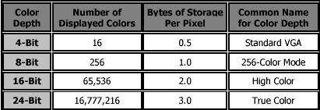
Computer Graphics, Nepal College of Information Technology, 2009

Slide 53
Emissive Displays
The emissive display converts electrical energy into light energy.
The image is Produced directly on the screen
Phosphors convert electron beams or UV light into visible light
      Cathode Ray Tube (CRT)
      Field emission display (FED)
      Surface-conduction Electron-emitter Display (SED)
      Vacuum Fluorescent Display (VFD)
      Electroluminescent Displays (ELD)
      Light- Emitting Diode Displays (LED)
      Plasma Display Panel (PDP)
      Electrochemical Display (ECD)
Non-Emissive Displays
Light is produced behind the screen and the image is formed by filtering this light
The Non emissive are optical effects to convert the sunlight or light from any other source to graphic form. Liquid crystal display is an example.
Computer Graphics, Nepal College of Information Technology, 2009

Slide 54
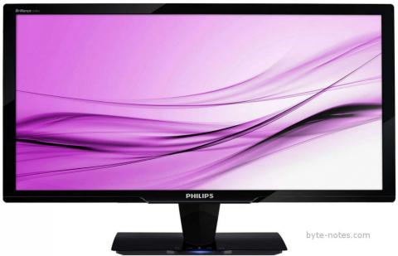
Light Emitting Diode Monitors
Light Emitting Diode (LED) is an improved version of LCD monitor and manufacturers have tried to eliminate the drawbacks of LCD monitors.
They differ in backlighting as LCD monitors use Cold Cathode Fluorescent Light and LED monitors are based on light emitting diode.
The backlighting impacts badly on the image and decreases its sharpness and brightness.
WLED and RGB LED are the two types of LED monitors, depending on the way LED placed in the panel.
Computer Graphics, Nepal College of Information Technology, 2009

Slide 55
Benefits of LED over CRT and LCD Monitors
LED monitors give a high-quality image with vibrant colors and viewing comfort.
LCD monitors are unable to display black and white image while LED monitors are capable of producing true black hues.
It consumes less electrical energy than CRT and LCD monitors as a cold cathode fluorescent lamp is embedded in the panel.
The absence of mercury makes it eco-friendly while zero percent flickering removes the chances of strain on the eyes
Computer Graphics, Nepal College of Information Technology, 2009

Slide 56
Video Display StandardsVideo Electronics Standards Association (VESA), which consists of video card and monitor manufacturers, develops video stands to define the resolution, number of colors, and other display properties.
  Monochrome Display Adapter (MDA)
  Hercules Graphics Card
  Color Graphics Adapter (CGA)
  Enhanced Graphics Adapter (EGA)
  Video Graphics Adapter (VGA)
  Super VGA (SVGA) and Other Standards Beyond VGA
Computer Graphics, Nepal College of Information Technology, 2009

Slide 57
Video Display StandardsVideo Electronics Standards Association (VESA), which consists of video card and monitor manufacturers, develops video stands to define the resolution, number of colors, and other display properties.
  Monochrome Display Adapter (MDA)
  Hercules Graphics Card
  Color Graphics Adapter (CGA)
  Enhanced Graphics Adapter (EGA)
  Video Graphics Adapter (VGA)
  Super VGA (SVGA) and Other Standards Beyond VGA
Computer Graphics, Nepal College of Information Technology, 2009

Slide 58
LCD (Liquid Crystal Display)
LCD (Liquid Crystal Display)
  A type of flat-panel display
  Uses liquid crystals between two sheets of material to present information on a screen
  An electric current passes through the liquid crystals, they twist
  Depending on how much they twist, some light waves are passed through while other light waves are blocked. This creates the variety of color that appears on the screen

Slide 59
How LCD works?
Step 2. As light passes through liquid crystal, electrical charge causes some of the cells to twist, making light waves bend as they pass through color filter.
Step 1. Panel
of fluorescent
tubes emits
light waves
through
polarizing glass filter, which guides light toward layer of liquid crystal cells.
Liquid crystal cells
Step 3. When light reaches second polarizing glass filter, light is allowed to pass through any cells that line up at the first polarizing glass filter. Absence and presence of colored light cause image to display on the screen.
Transparent electrodes
Alignment layer
Color filter
Polarizing glass filter
Fluorescent tube panel

Slide 60
LCD (Liquid Crystal Display)
LCD monitors produce color using either passive-matrix or active-matrix technology
Active-matrix display, also known as a TFT (thin-film transistor) display, uses a separate transistor to apply changes to each liquid crystal cell and thus display high-quality color that is viewable from all angles

Slide 61
LCD (Liquid Crystal Display)
Passive-matrix display uses fewer transistors and requires less power than an active-matrix display
The color on a passive-matrix display often is not as bright as an active-matrix display
Users view images on a passive-matrix display best when working directly in front of it
Passive-matrix displays are less expensive than active-matrix displays

Slide 62
LCD (Liquid Crystal Display)
An importance measure of LCD monitors is the response time, which is the time in millisecond (ms) that it takes to turn a pixel on or off
LCD monitors’ response times average 25 ms
The lower the number, the faster the response time
Brightness of an LCD monitor is measured in nits
Nit is a unit of visible light intensity equal to one candela meter
Resolution and dot pitch determines quality of LCD monitor

Slide 63
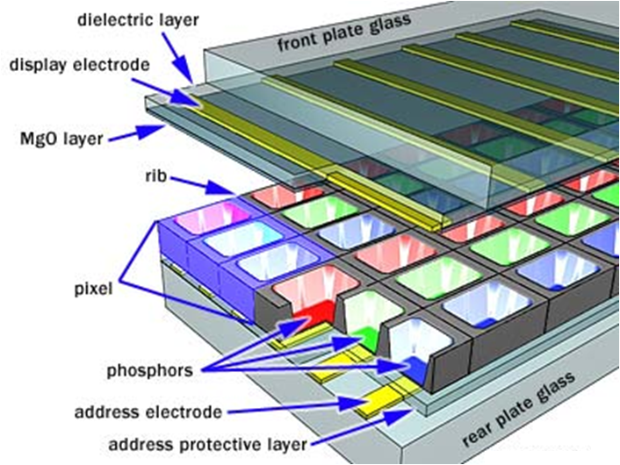
Gas plasma monitor
A flat-panel display that uses gas plasma technology
A layer of gas between two sheets of material
When voltage is applied, the gas releases ultraviolet (UV) light that causes the pixels on the screen to glow and form an image
Larger screen sizes and higher display quality than LCD, but much more expensive

Slide 64
Hard Copy Devices: Printers
Printed output is referred to as hard copy and do not require electric power as they are printed on papers to read after printing and provide permanent readable form information
According to how they print printers can be of different types:
Character printers prints one character of a text at a time
Line printer prints one line of the text at a time
A page printer prints one page of the text a t a time
According to the technology used printers produce output by either impact or non impact methods

Slide 65
Hard Copy Devices: Printers
Impact printers Impact printers press the formed character faces against an inked ribbon onto paper
Character impact printers often have a dot matrix print head containing a rectangular array of protruding wire pins with a number of pins depending on the quality of the printer
Individual characters or graphics patterns are obtained by retracting certain pins so that the remaining pins form the pattern to be printed.
Non-Impact Printers Non impact printers use laser techniques, ink-jet sprays etc to get images onto paper.

Slide 66
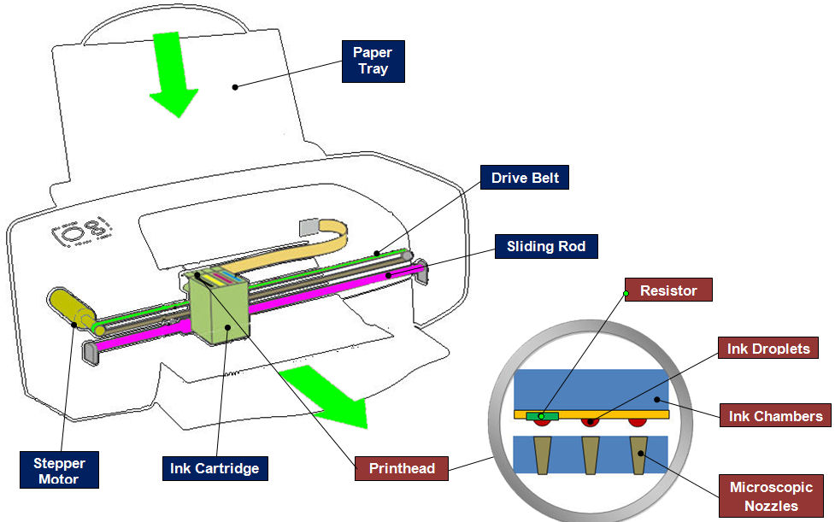
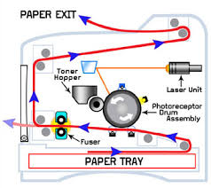

Slide 67
Line Drawing
Point plotting is accomplished by converting a single coordinate position by an application program into approximate operation for the output device in use.
CRT electron beam is turned on to illuminate the screen phosphor at selected location.
Computer Graphics, Nepal College of Information Technology, 2009

Slide 68
Line Drawing
In random scan system, point plotting commands are stored in display list and coordinate values in these instructions are converted to deflection voltages that position the electron beam at that screen location to be plotted during each refresh cycle.
In case of black and white raster scan system a point is plotted by setting the bit value corresponding to specified screen position within frame buffer to 1.
Computer Graphics, Nepal College of Information Technology, 2009

Slide 69
Line Drawing
For drawing lines, we need to calculate intermediate positions along the line path between two end points
e.g. 10.45 is rounded off to 10 (this causes stair cases or jaggies to be formed)
To load intensity value into frame buffer at position x, y we use function
setpixel (x, y, intensity)
To retrieve current frame buffer intensity value for specified location we use getpixel(x,y)
4
3
?
2
?
1
1
2
3
4
Computer Graphics, Nepal College of Information Technology, 2009

Slide 70
DDA (Digital Differential Analyzer)
Slope intercept equation of a straight line is y = m x +c
For points (x1, y1) and (x2,y2) slope m = y2 – y1/x2 - x1 or Δy/Δx
Algorithms for displaying lines depend on these equations for given interval x we can compute y interval
Δy = m . Δx
‘x’ interval Δx is obtained by Δx = Δy/m
These equations form the basis for determining deflection voltages in analog devices
Computer Graphics, Nepal College of Information Technology, 2009

Slide 71
DDA (Digital Differential Analyzer)
For lines with slope m = 1, Δy and Δx are equal
DDA scan conversion algorithm is based on calculating Δx, Δy
We sample line at unit interval in one coordinate and determine corresponding integer values nearest the line path for other coordinate
Computer Graphics, Nepal College of Information Technology, 2009

Slide 72
DDA (Digital Differential Analyzer)
Positive Slope
For slope < 1
x > y
y_{k+1} – y_{k} = m
or y_{k+1} = y_{k} + m
y_{k+1}
y
x_{k}
x_{k+1}
Moving from left to right
Computer Graphics, Nepal College of Information Technology, 2009

Slide 73
DDA (Digital Differential Analyzer)
Positive Slope
For slope < 1
y > x
x_{k+1} – x_{k} = 1/m
or x_{k+1} = x_{k} + 1/m
y_{k+1}
y_{k}
x_{k}
x_{k+1}
Moving from left to right
Computer Graphics, Nepal College of Information Technology, 2009

Slide 74
DDA (Digital Differential Analyzer)
Negative Slope
For slope < 1
y > x
y_{k+1} – y_{k} = m
or y_{k+1} = y_{k} + m
y_{k+1}
y_{k}
x_{k}
x_{k+1}
Moving from left to right
Computer Graphics, Nepal College of Information Technology, 2009

Slide 75
DDA (Digital Differential Analyzer)
Negative Slope
For slope > 1
y > x
or x_{k+1} = x_{k} – m ?
y_{k+1}
y_{k}
x_{k}
x_{k+1}
Moving from left to right
Computer Graphics, Nepal College of Information Technology, 2009

Slide 76
DDA (Digital Differential Analyzer)
Advantages:
Accurate
Disadvantages :
Slower as it uses floating point arithmetic
Computer Graphics, Nepal College of Information Technology, 2009

Slide 77
Bresenham’s Line Drawing Algorithm
Accurate and easier line drawing algorithm by Bresenham
Vertical axis: scan line
Horizontal axis: pixel column
For slope < 1 sample at unit ‘x’ interval in ‘x’ direction, determine which of the two possible pixel positions is closer to the line path at each sample step.
Bresenham’s algorithm gives the solution to this problem by testing the sign of the integer parameter whose value is proportional to difference between the separation of two pixel positions from actual line path.
Computer Graphics, Nepal College of Information Technology, 2009

Slide 78
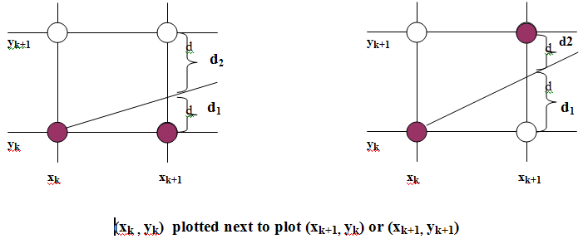
Line Drawing
Computer Graphics, Nepal College of Information Technology, 2009

Slide 79
Line Drawing
Algorithm for 0<m<1
  Input the two line endpoints and store the left end point in (x₀, y₀)
  Load (x₀, y₀) into the frame buffer; that is, plot the first point
  Calculate constants Δx, Δy, 2Δy, and 2Δy− 2Δx, and obtain the starting value for the decision parameter as
  At each x_{k} along the line, start at k =0, perform the following test:
    If p_{k} < 0, the next point to plot is (x_{k}+1, y_{k}) and
    Otherwise, the next point to plot is (x_{k}+1, y_{k}+1) and
  Repeat step 4 Δx times
Computer Graphics, Nepal College of Information Technology, 2009

Slide 80
Dot Pitch
  The distance between adjacent sets of red, green and blue dots.
  The dot pitch of the monitor indicates how fine the dots are that make up the picture.
  The smaller the dot pitch, the more sharp and detailed the image.
Computer Graphics, Nepal College of Information Technology, 2009

Slide 81
Filled Area Primitives
Standard output primitive in graphics packages is solid color ,patterned polygon area
Polygons are easier to process due to linear boundaries
Two basic approaches to area filling on a raster system
1. Determine the overlap intervals for scan lines that cross the area.
Typically useful for filling polygons, circles, ellipses
2.Start from a given interior position and paint outwards from
this point until we encounter the specified boundary conditions
useful for filling more complex boundaries, interactive painting
system.
Computer Graphics, Nepal College of Information Technology, 2009

Slide 82
Filling rectangles
Two things to consider
i. which pixels to fill
ii. with what value to fill
Move along scan line (from left to right) that intersect the primitive and fill in pixels that lay inside
To fill rectangle with solid color
Set each pixel lying on scan line running from left edge to right with same
pixel value, each span from x _{max} to x _{min}
for( y from y _{min} to y _{max} of rectangle) /*scan line*/
for( x from x _{min} to x _{max} of rectangle) /*by pixel*/
writePixel(x, y, value);
Computer Graphics, Nepal College of Information Technology, 2009

Slide 83
Filling Polygons
Filling Polygons
  Scan-line fill algorithm
    Inside-Outside tests
  Boundary fill algorithm
11
1
2
3
4
5
6
7
8
9
10
5
6
7
8
9
4
3
1
2
Computer Graphics, Nepal College of Information Technology, 2009

Slide 84
Topological Difference between 2 Scan lines
  y : intersection edges are opposite sides
  y’ : intersection edges are same side
y
1
2
2
y’
1
1
Computer Graphics, Nepal College of Information Technology, 2009

Slide 85
Topological Difference between 2 Scan lines
  y : intersection edges are opposite sides
  y’ : intersection edges are same side
y
1
2
2
y’
1
1
Computer Graphics, Nepal College of Information Technology, 2009

Slide 86
Edge Sorted Table
B
y_{C}
y_{B}
x_{C}
1/m_{CB}
C
C’
E
y_{D}
y_{C’}
x_{D}
1/m_{DC}
y_{E}
x_{D}
1/m_{DE}
D
y_{A}
y_{E}
x_{A}
1/m_{AE}
y_{B}
x_{A}
1/m_{AB}
A
1
Scan-Line Number
0
Computer Graphics, Nepal College of Information Technology, 2009

Slide 87
Proceed to Neighboring Pixels
  4-Connected
  8-Connected
Computer Graphics, Nepal College of Information Technology, 2009

Slide 88
Boundary Fill
Start at a point inside a region and paint the interior outward toward the boundary.
If boundary is specified in a single color the fill algorithm proceeds outward pixel by pixel until the boundary color is encountered
Accepts as input coordinates of an interior point (x, y) a fill color and boundary color.
Starting from (x, y) the procedure tests neighboring position to determine whether they are of the boundary color.
If not they are painted with fill color and their neighbors are tested
Process continues until all pixels up to boundary color for the area have been tested
Computer Graphics, Nepal College of Information Technology, 2009

Slide 89
boundaryFill ()
Retrive intensity of the pixel inside the boundary
If the retreived intensity is not that of the boundary pixels and AND it is not
the fill color
use recursion to plot pixel in all four directions
Computer Graphics, Nepal College of Information Technology, 2009

Slide 90
boundaryFill(int x,y,fill_color, boundary_color){
int color;
getpixel(x,y,color)
if(color != boundary_color AND color != fill_color ){
setpixel( x,y,fill_color)
boundaryFill( x+1,y,fill_color, boundary_color)
boundaryFill( x,y+1,fill_color, boundary_color)
boundaryFill( x-1,y,fill_color, boundary_color)
boundaryFill( x,y-1,fill_color, boundary_color)
}
}
Computer Graphics, Nepal College of Information Technology, 2009

Slide 91
Flood Fill
Filling an area that is not defined within a single color boundary.
In this case replace a specified interior color instead of searching for boundary color value.
Start from specified interior point (x , y) and reassign all pixel values that are currently set to a given interior color with the desired color.
If the area we want to paint has more than 1 interior color , first assign pixel values so that all interior points have same color.
We can then use 8 or 4 connected approach to move on until all interior points have been repainted.
Computer Graphics, Nepal College of Information Technology, 2009

Slide 92
floodFill(int x,y,fill_color, original_color){
int color;
getpixel(x,y,color)
if(color == original_color ){
setpixel(x,y,fill_color)
floodFill(x+1,y,fill_color, original_color)
floodFill(x,y+1,fill_color, original_color)
floodFill(x-1,y,fill_color, original_color)
floodFill(x,y-1,fill_color, original_color)
}
}
Computer Graphics, Nepal College of Information Technology, 2009

